Slide 1
Free Your Metadata
October 12, 2017

Slide 2


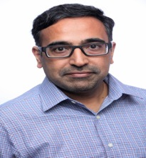
TODAY’S GUESTS
Mandy Chessell, IBM Distinguished Engineer
Ferd Scheepers,
Chief Information Architect at ING
Srikanth Venkat
Sr. Director of Product Management, Hortonworks
Moderator:
John Mertic, Director of Program Management, ODPi

Slide 3
IMAGINE …
An enterprise data catalogue that lists all of your data, where it is located, its origin (lineage), owner, structure, meaning, classification and quality
No matter where the data resides
Search

Slide 4
IMAGINE …
Search
Open Metadata Management & Governance
New tools from any vendor connect to your data catalogue out of the box
No vendor lock-in and no expensive population of yet another proprietary, siloed metadata repository

Slide 5
IMAGINE …
Metadata is added automatically to the catalogue as new data is created
Databases
Files
Function
Applications
Function
Functions
It’s possible if data-driven enterprises collaborate to build it
Let’s talk about how

Slide 6
AGENDA
The Metadata Problem
Building an Open Ecosystem
Benefits for Data Governance Professionals

Slide 7
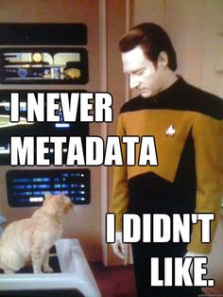
WHY DO WE NEED METADATA?
Use data outside the application that created it
Find the right data sets
Automate governance processes
Notes:
Metadata enables data to be used outside of the application that created it.
Analytics and decision making
New business applications
Reporting and compliance
Metadata describes the format and content of data allowing people to judge which data set to use for a new project
Structure
Meaning
Origin
Valid values and quality
Usage and ownership
Regulations and classifications that apply
<more>
Metadata describes the business context and classification of data allowing automated governance processes to operate.

Slide 8
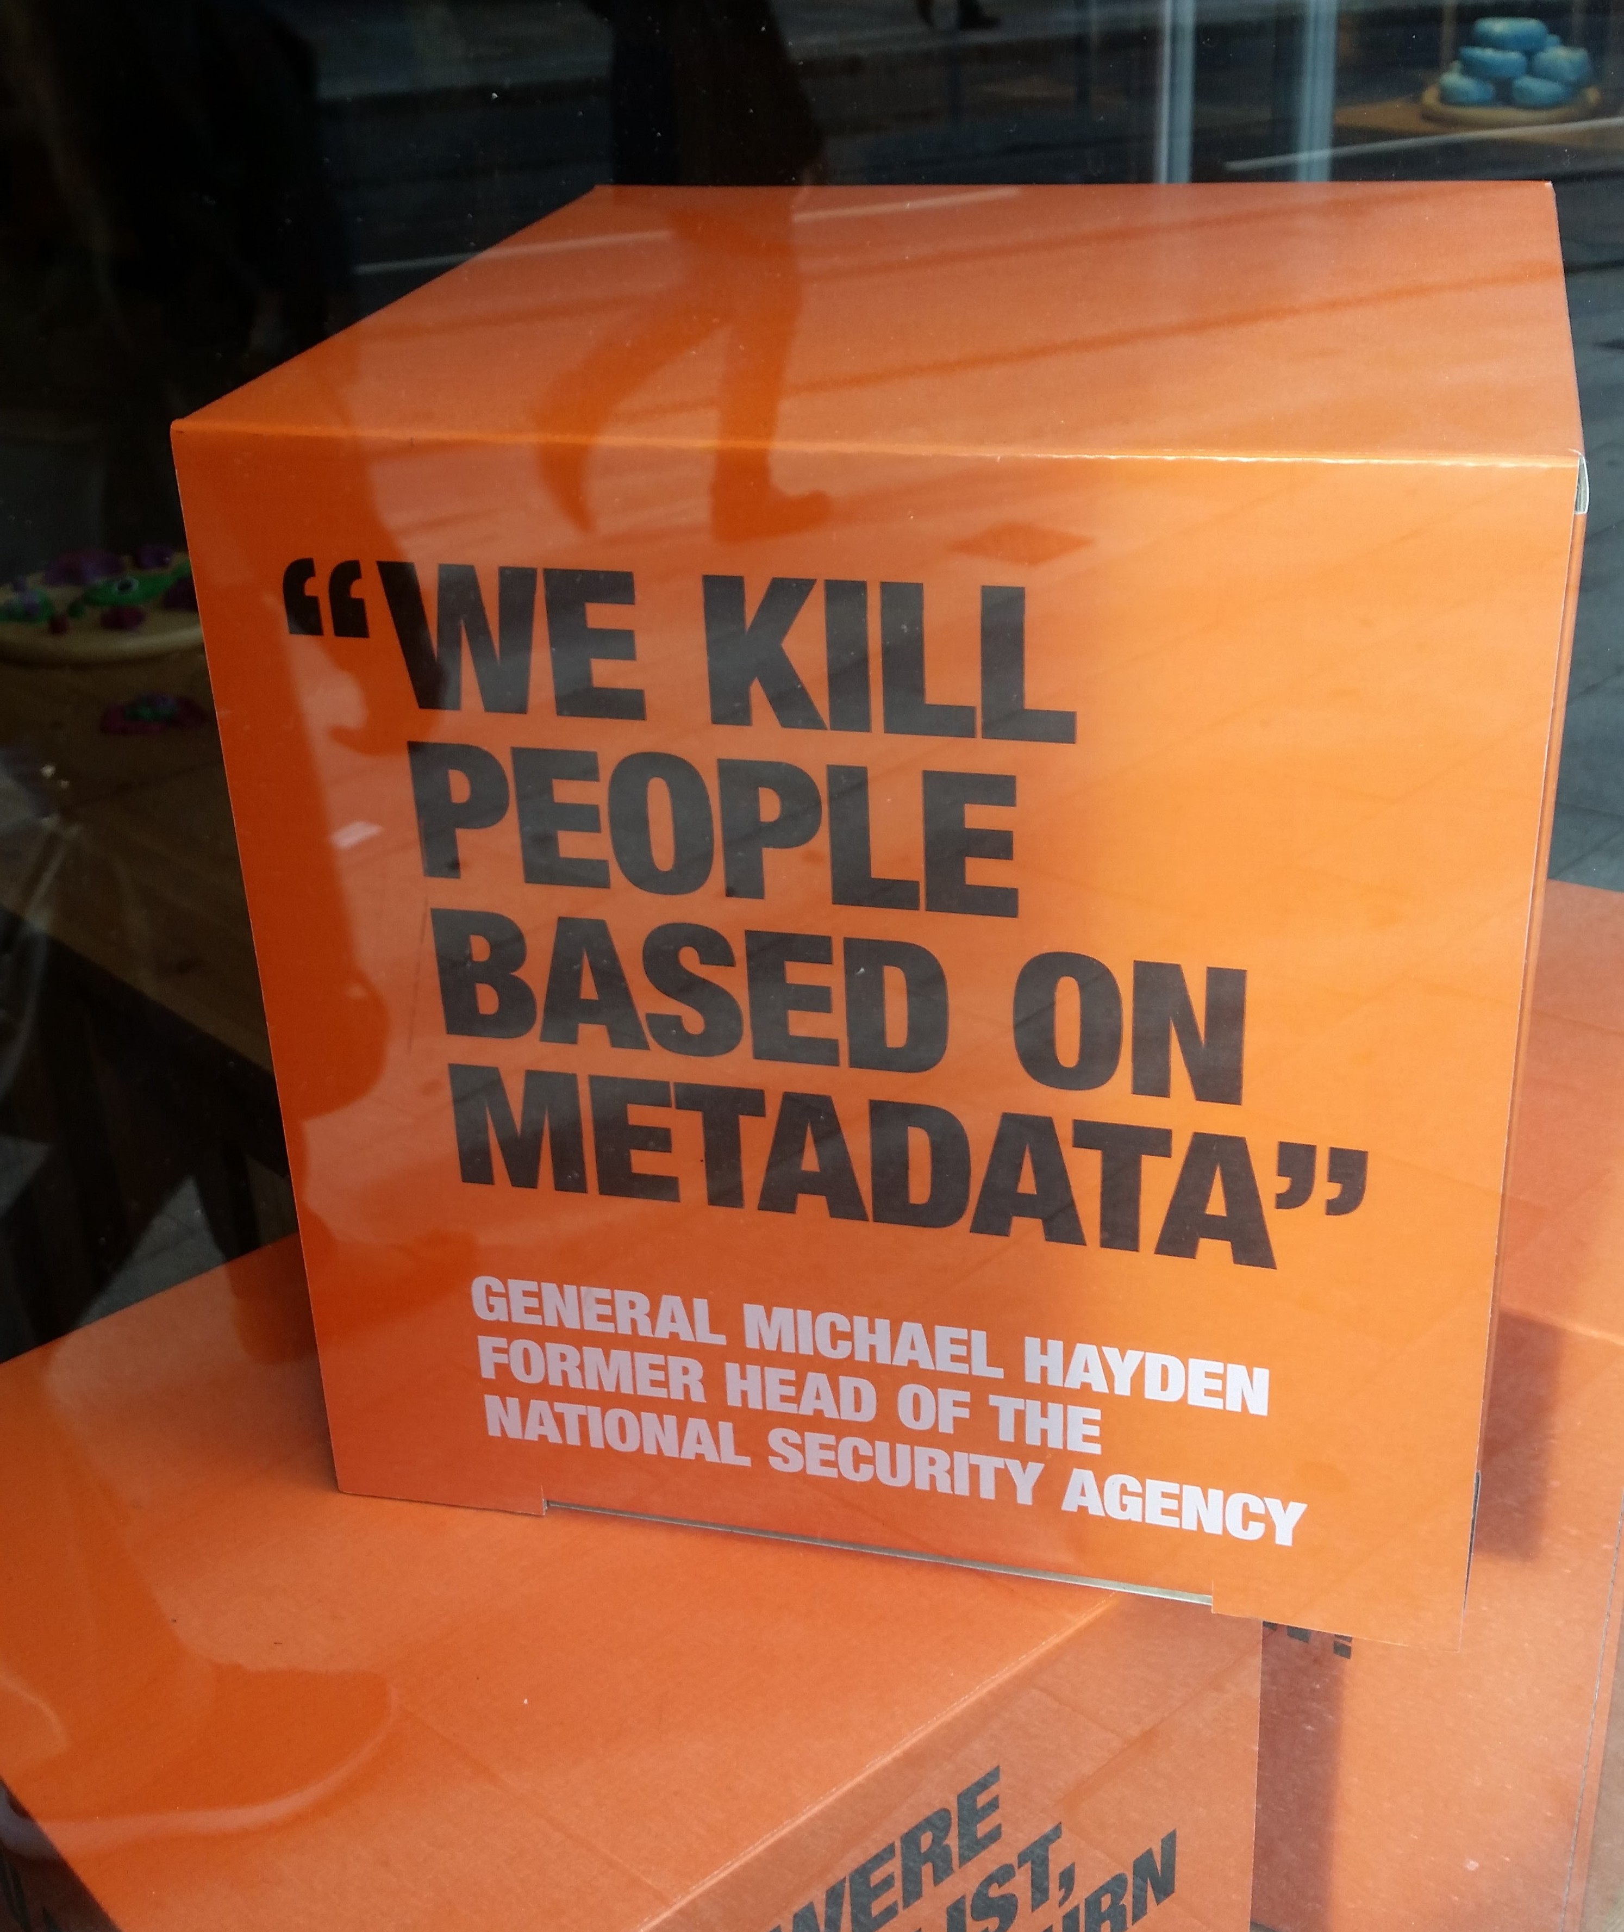
TODAY’S REALITY
Many data platforms do not have metadata support
Proprietary tools support a limited range of data sources and governance actions
Expensive efforts to create an enterprise data catalogue
Notes:
Many data platforms do not have metadata support
Proprietary tools support a range of data sources and governance actions
No-one supports everything you need and assumes all tools come from their suite
Each tool starts “empty” requiring effort to populate metadata
Each tool operates as if it is the only tool
No integration/interoperability of metadata repositories from different vendors
Expensive efforts to create an enterprise data catalogue

Slide 9
TODAY’S REALITY

Slide 10
METADATA GOVERNANCE MANIFESTO
The maintenance of metadata must be automated
Metadata management must become ubiquitous
Metadata access must become open and remotely accessible
Metadata should be used to drive the governance of data
Wherever possible, discovery and maintenance of metadata has to an integral part of all tools that access, change and move information.
10
Notes:
The maintenance of metadata must be automated to scale to the sheer volumes and variety of data involved in modern business.
Metadata management must become ubiquitous in cloud platforms and large data platforms, such as Apache Hadoop so that the processing engines on these platforms can rely on its availability and build capability around it.
Metadata access must become open and remotely accessible so that tools from different vendors can work with metadata located on different platforms. This implies unique identifiers for metadata elements, some level of standardization in the types and formats for metadata and standard interfaces for manipulating metadata.
Metadata should be used to drive the governance of data and create a business friendly logical interface to the data landscape.
Wherever possible, discovery and maintenance of metadata has to an integral part of all tools that access, change and move information.

Slide 11
WHAT NEEDS TO CHANGE
Open and
Unified Metadata
Open Metadata Access Service
Open and Unified Metadata
Open Metadata Repository Service
Custom Metadata repository
IBM
Metadata repository
Atlas
Metadata repository

Slide 12











CO-CREATION WITH PRACTITIONERS
Good metadata enables subject matter experts to collaborate around the data
Locate the data they need, quickly and efficiently
Feeding back their knowledge about the data and the uses they have made about it to help others and support economic evaluation of data
Notes:
Mandy prompt Ferd about how involvement of ING has shaped the program and Ferd on how ING benefits from being involved. Please get into business and technical specifics – focus on VALUE derived

Slide 13
HOW THIS HELPS
Data Governance Professionals
Vendors
Your governance program if based on established definitions
Allow a broader range of tools in your organization
Automated governance processes protect and manage your data
Metadata-driven access control
Auditing, metering and monitoring
Quality control and exception management
Rights management
Your metadata offerings will deliver value faster as they tap into metadata collected by other vendor’s tools.
ODPi packages extend your metadata system’s and tools’ capabilities
Conformance tests minimize your effort in being compliant with key standards and regulations.
Customers have increased confidence in your tools and services due to ODPi certification.

Slide 14
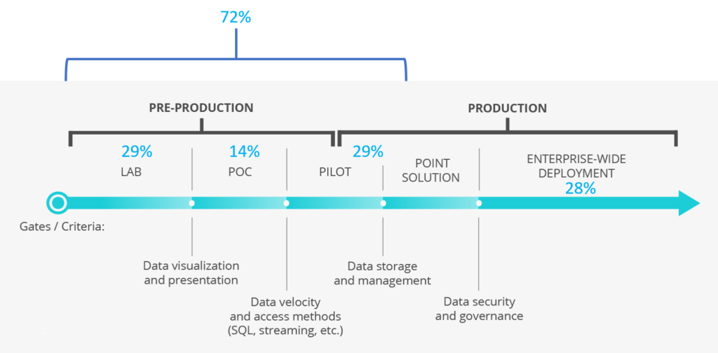
ODPi – A NEUTRAL HOME FOR COLLABORATION
Notes:
ODPi, a Linux Foundation Project, can provide the platform for industry collaboration on shared technology
In pursuit of its mission to make Apache Hadoop and associated Big Data solutions ready for enterprise-wide deployment, ODPi is focused on the biggest hurdles
In 2016, the largest hurdles were cross-distro harmonization
Today, a key blocker to broad-based production use of Big Data is Governance

Slide 15
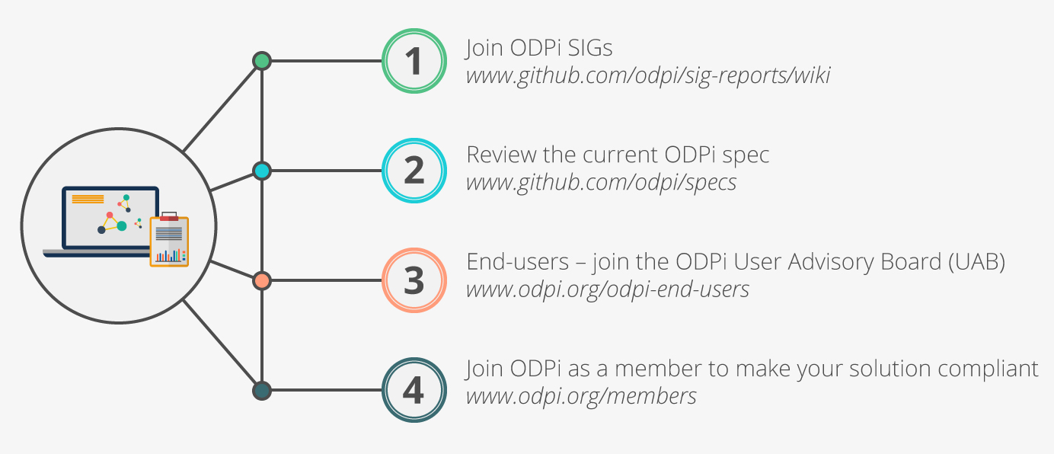
GET INVOLVED WITH ODPi DATA GOVERNANCE
Check out ODPi Data Governance on GitHub
https://github.com/odpi/data-governance
Join the ODPi User Advisory Board
https://www.odpi.org/odpi-compliance-directory/odpi-end-users
See how Apache Atlas is implementing this
https://cwiki.apache.org/confluence/display/ATLAS/Open+Metadata+and+Governance
Have your organization support ODPi
https://www.odpi.org/about/join
Notes:
Mention that individuals can get involved.

Slide 16
z
z
z
z
z
z
z
Questions?

Slide 17
